Slide 1


THE STATE OF THE .NET AUTH, CLOUD SECURITY
Damien Bowden
Microsoft MVP
https://damienbod.com

Slide 2
State of ASP.NET Core, .NET authentication
passkeys, FIDO2
Self Sovereign Identity, E-ID Schweiz, eIDAS
Some security recommendations
Trends from OAuth2 and OpenID Connect

Slide 3
.NET 7 & .NET 8
A big push in authentication, new APIs, docs in .NET 8
Still using tokens in the browser ☹ The time for secure cookies in now.
Too many solutions in .NET and not sticking to the standards.
Every producer seems to make different client library wrappers

Slide 4
.NET 8 templates, solutions
Moving back to less secure solutions with weak interoperability ☹
OIDC, OAuth2 client templates are missing
(Apart from Microsoft Entra ID)

Slide 5
ASP.NET Core Identity APIs
Using a username, password to request an access token for a public client is a bad idea
Simple but unsecure!
Impersonation
Phishing
Access token storage problems
Client hijacking
MFA

Slide 6
ASP.NET 8 security docs
New docs in the making, looking good already
Feedback is wanted, get involved
Decision flow chart

Slide 7
.NET YARP reverse proxy
Isolate your legacy solutions
Great solution for implementing app moderization
Downstream APIs
Just awesome in so many ways ☺

Slide 8

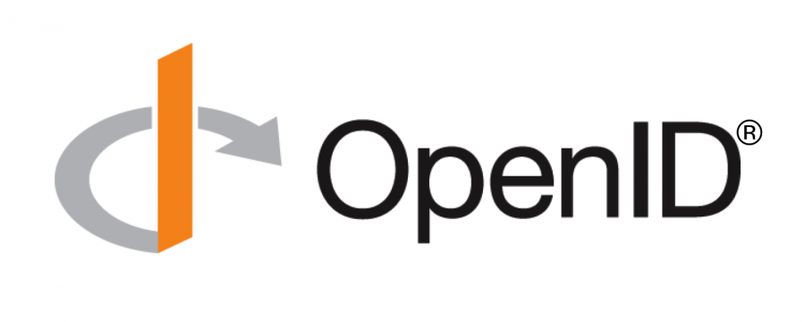

Slide 9
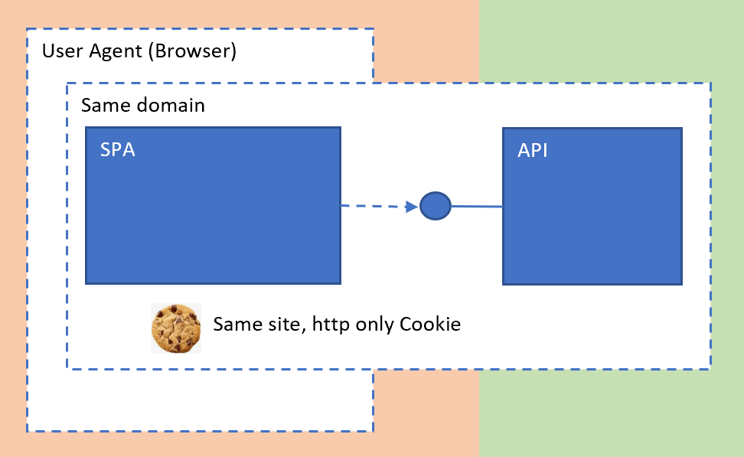
OAuth 2.0 for Browser-Based Apps
https://datatracker.ietf.org/doc/draft-ietf-oauth-browser-based-apps/

Slide 10
Backend for frontend security
Improved security
Recommended security architecture for modern Web UIs
Industry is moving on from tokens for web applications
Not all services, cloud solutions have adopted, (Or want to adopt)

Slide 11
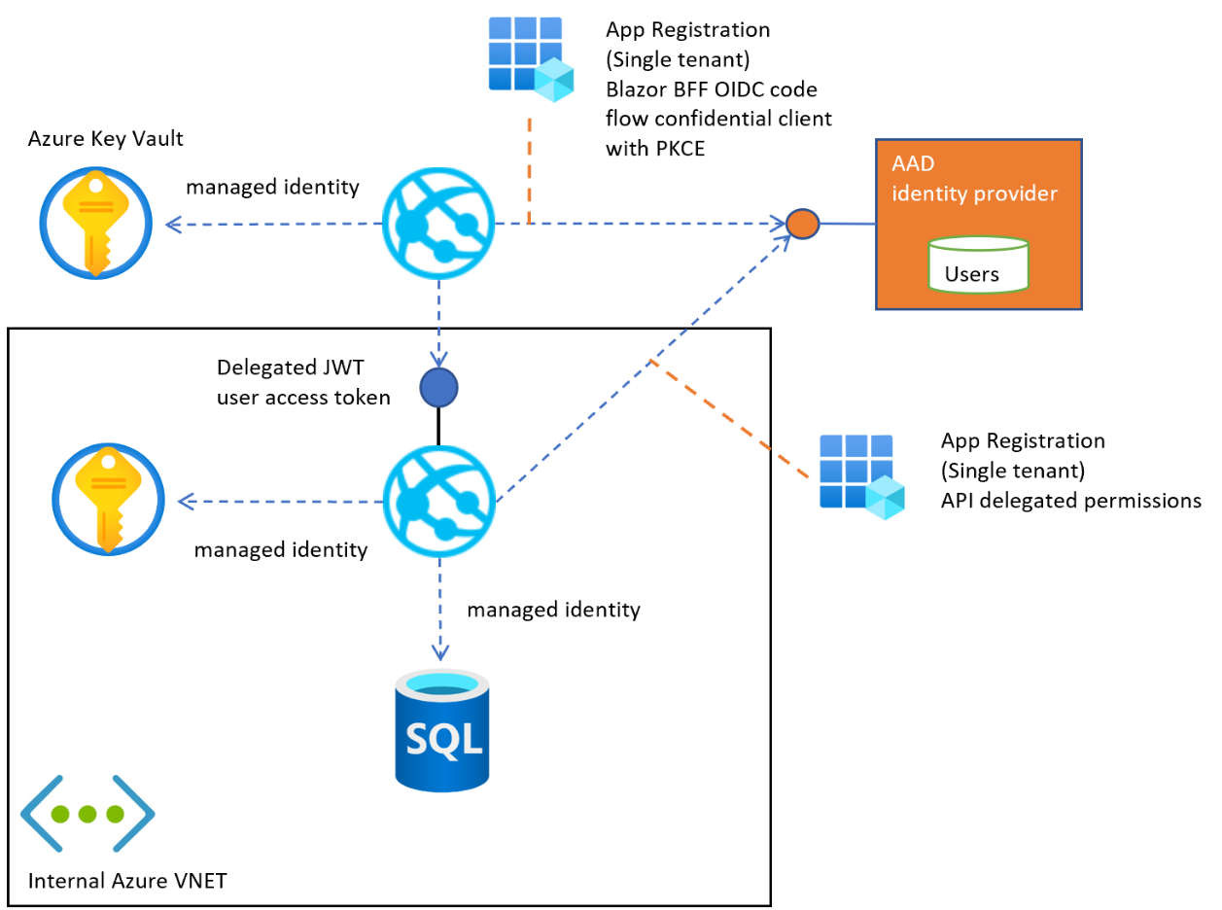
BFF with reverse proxy

Slide 12
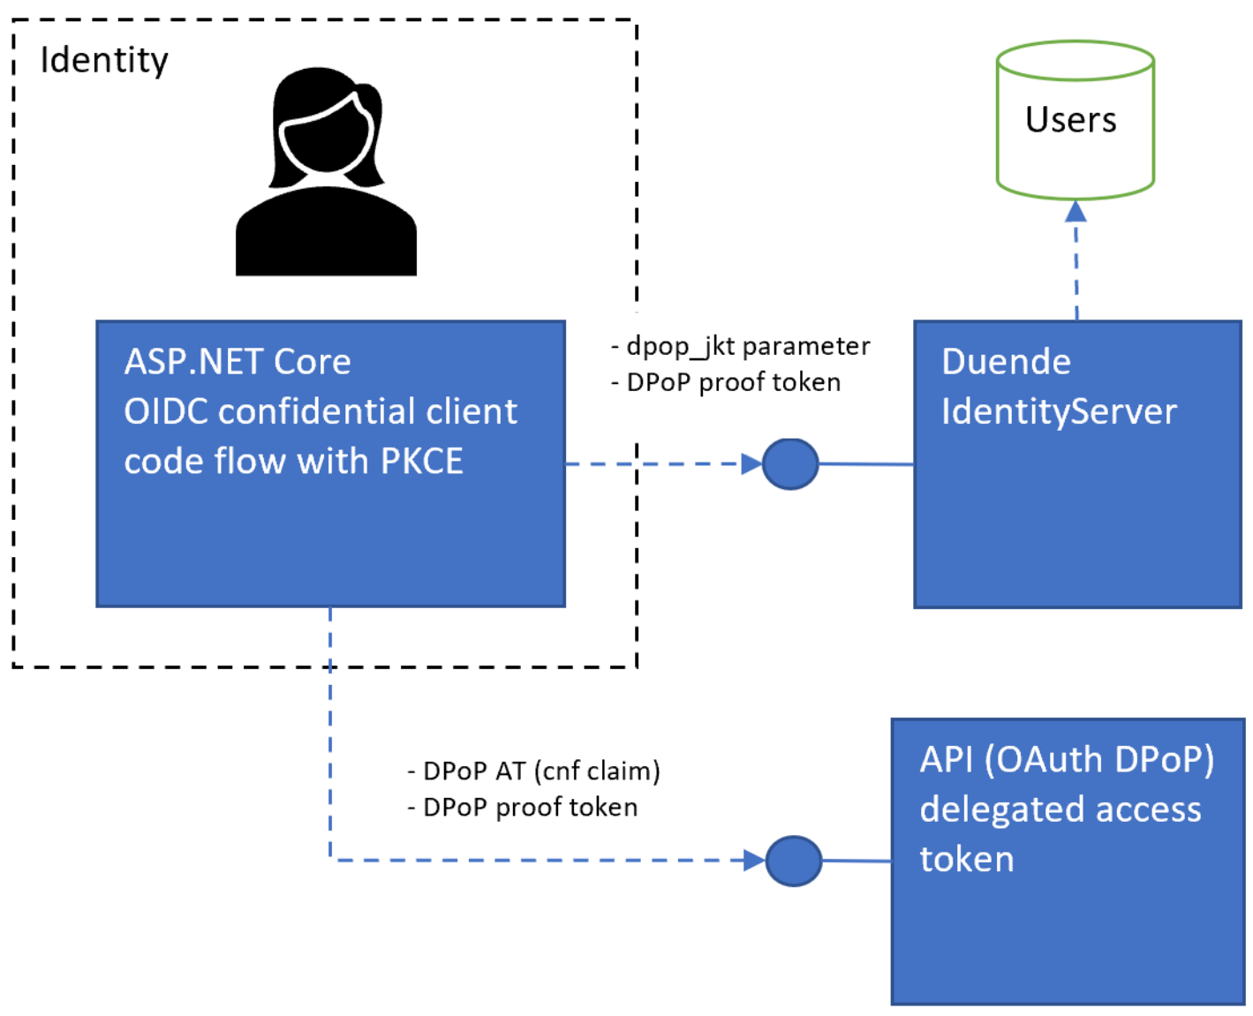
OAuth 2.0 Demonstrating Proof-of-Possession at the Application Layer (DPoP)
https://datatracker.ietf.org/doc/html/draft-ietf-oauth-dpop

Slide 13
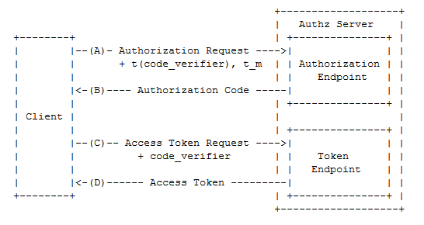

Slide 14
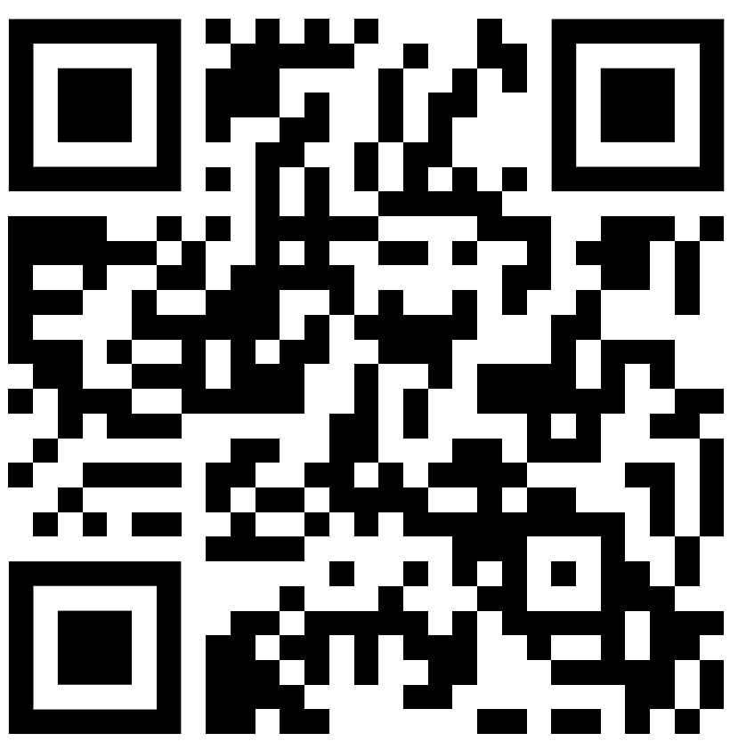
Cross Device authentication
Scan this QR code

Slide 15
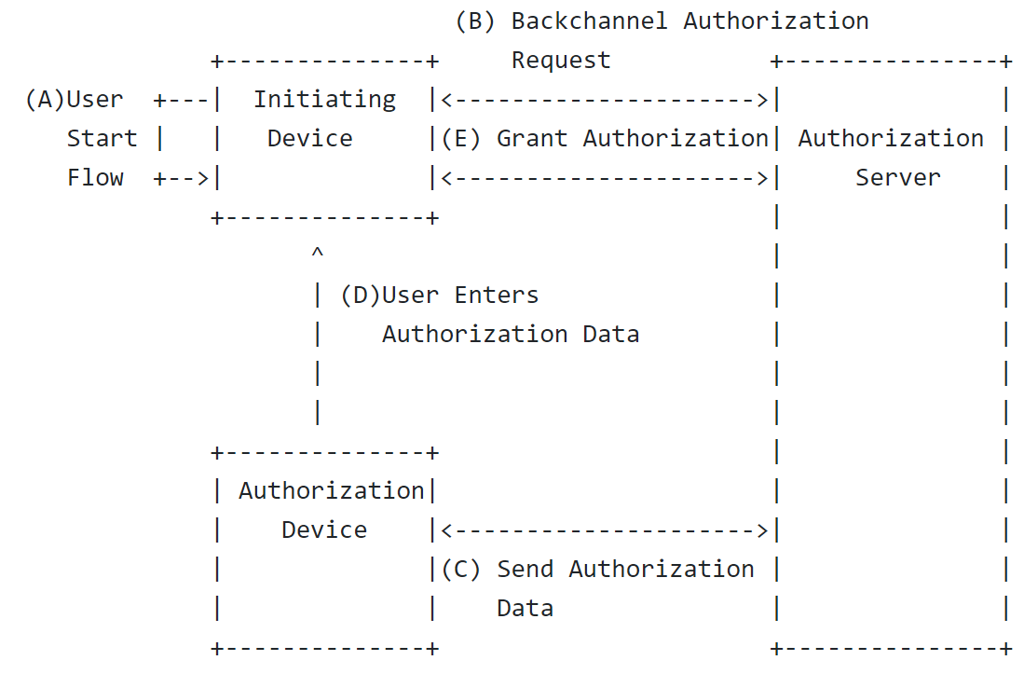
Cross-Device Flows: Security Best Current Practice
https://datatracker.ietf.org/doc/draft-ietf-oauth-cross-device-security/

Slide 16
Cross Device authentication
Never trust a QR Code
Mind the GAP problem
Open to phishing attacks
Aim for phishing resistant authentication!
Certificate authentication
FIDO2, passkeys
Windows for business

Slide 17

passkeys, FIDO2 Move away from Authenticators and SMS

Slide 18
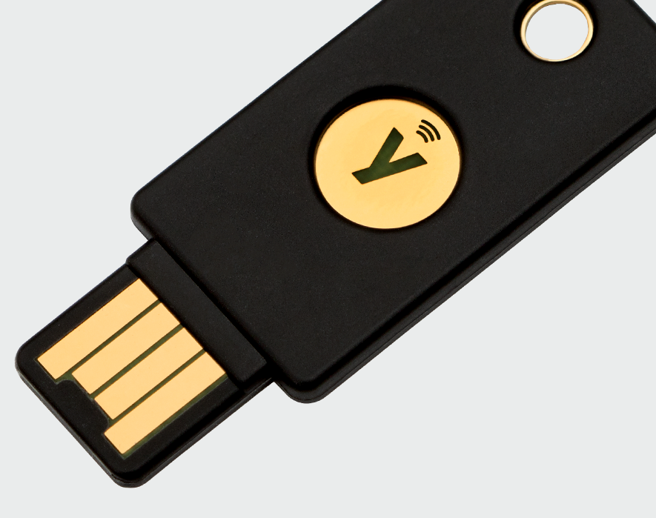
FIDO2
Fast IDentity Online

Slide 19
FIDO2, passkeys are awesome

Slide 20
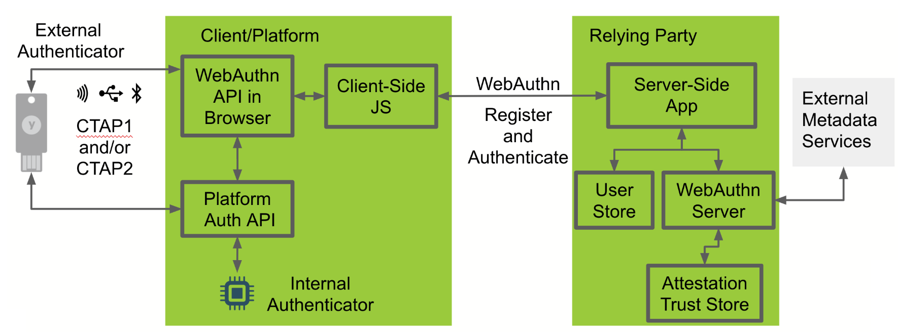
https://github.com/YubicoLabs/java-webauthn-passwordless-workshop

Slide 21
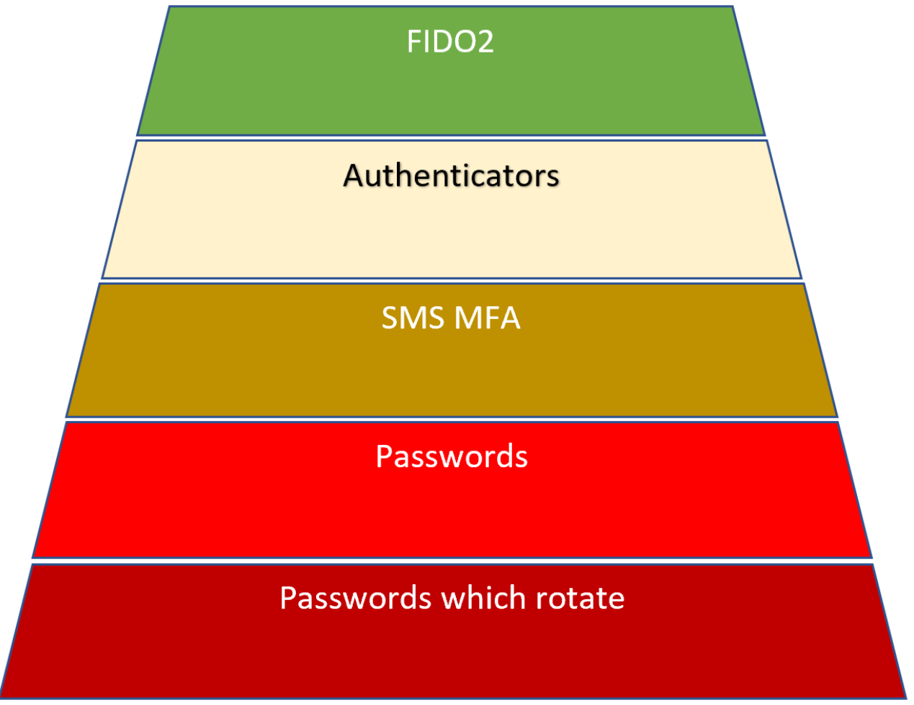

Slide 22
Self Sovereign Identity

Slide 23

What is a digital identity?

Slide 24
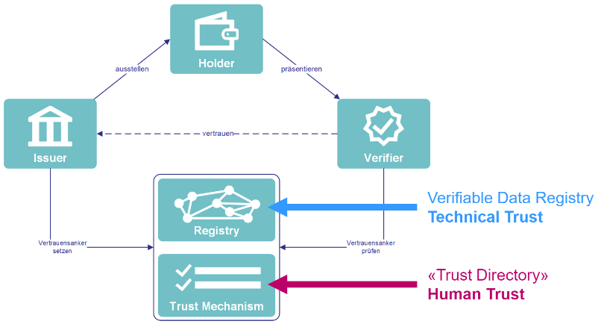

Slide 25
Schweiz E-ID 2025+
PoC built using legacy Hyperledger Aries, new Swiss Wallet
Unknown which VC types, standards will be supported
SIOP V2, Didcomm V1, Didcomm V2?
Over consent credential theft problem unsolved, Verifiers will collect data.
Less secure compared to existing systems (open to phishing attacks)
More complexity, identity solutions require a ledger layer to use SSI
Interop between SSI solutions, ledgers, wallets has no solution, vendor lockdown
Notes:
Is the PoC (future E-ID) built using the legacy Hyperledger Aries specifications?
Is Didcomm V1, Didcomm V2, SIOP supported (PoC and future E-ID)? (Didcomm V2, SIOP must be supported if you want interop.)
How do you prevent phishing (Scanning a QRCode to start any process is not safe, phishing resistant authentication is required for most business flows)
What VC specifications will be supported? BBS+? etc
How do you replace your mobile device in a secure way? (technical process details)
How do you technically implement a wallet (open specifications or a monopoly for the team creating the Bund wallet)?
How to you technically create a Verifier? (open specifications or are we forced to use ledger X from Company X)?
How do you invalidate a wallet which was stolen or is being abused?
How do you protect users from over consent credential theft? (some type of technical solution and law solution is probably required)
How does the user authenticate into his/her wallet? (technical specifications that will be supported)
How do you invalidate a set of VCs from a wallet? (kid turns 18 and is fighting with the parents use case )

Slide 26

Self Sovereign Identity is NOT a good solution for authentication
It is a good solution for online identity

Slide 27
Cross device authentication that starts from a QR Code is UNSECURE
Near device authentication which starts from a QR Code is secure (passkeys)

Slide 28
Some best practices

Slide 29

The old way…

Slide 30
Network/IT security versus App Security
One does not replace the other!
Use both
Do not use setups which prevent doing one or the other correctly!

Slide 31
Good security is not complex to implement or use
Less is more
KISS
Do not create custom solutions, complex solutions
Useability

Slide 32
Use a Zero Trust Strategy
Verify locally, implement security at the app and at the source
In production even when you use a WAF and K8s, use HTTPS
Do not use setups which prevent application security
Avoid moving the security to gateways, Firewalls, WAF
(You can do this as well)
Notes:
Verify explicitly (Never trust, always verify)
Least privilege (Blast radius)
Assume breach
Continuous evaluation

Slide 33
USE Standards
Don’t implement this yourself, use certified libs, packages, tested

Slide 34
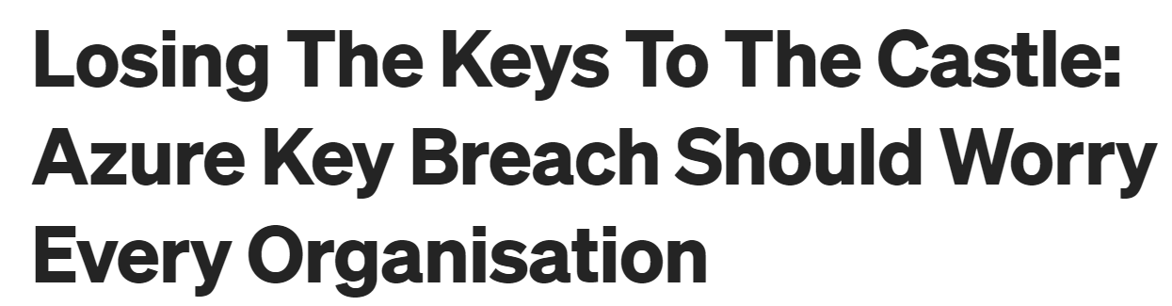
Move auth to the Cloud
Move away from On-Prem solutions
but not always…

Slide 35
Use a single cloud identity provider
Use a single cloud identity provider for applications.

Slide 36
Use HTTPS everywhere
Even in dev!

Slide 37
Never implement a username/password
You should never need to implement a username/password request
Use ASP.NET Core Identity if implementing your own identity provider and token server
Always delegate the IAM management to an existing system if possible or use a solution based on standards
Azure AD (Azure AD B2C)
Auth0
Keycloak
OpenIddict with ASP.NET Core Identity
IdentityServer with ASP.NET Core Identity

Slide 38
Team of 50 people focused on developing business solutions Security workshops, security consulting, DevOps Security Focus on hand crafted solutions generating business value .NET, Azure, App security, React, Blazor, Angular, Power Apps, Power BI & data

Slide 39
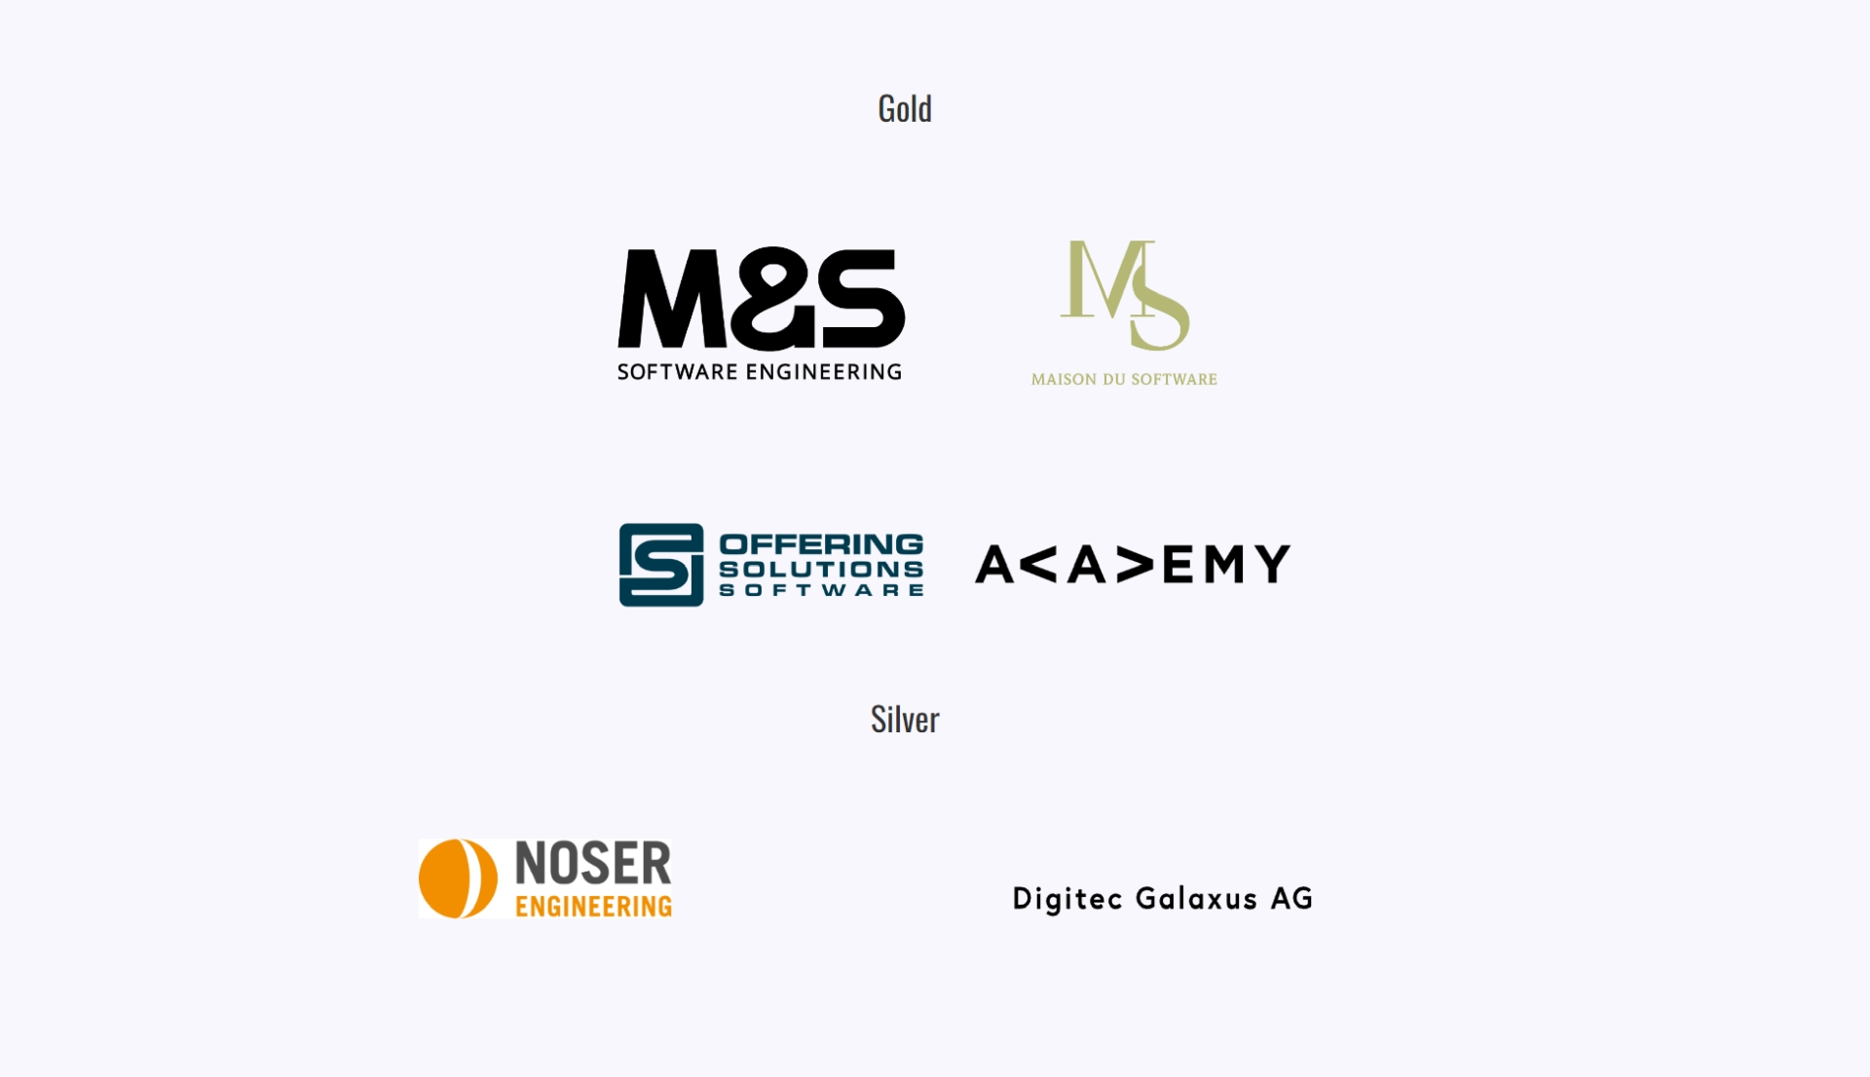

Slide 40
Thanks
https://github.com/damienbod
https://github.com/swiss-ssi-group
https://www.bj.admin.ch/bj/de/home/staat/gesetzgebung/staatliche-e-id.html
https://www.isolutions.ch/en/services/business-solutions/application-security/

